Slide 1
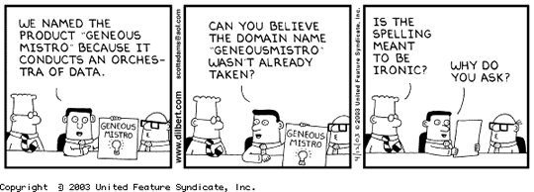
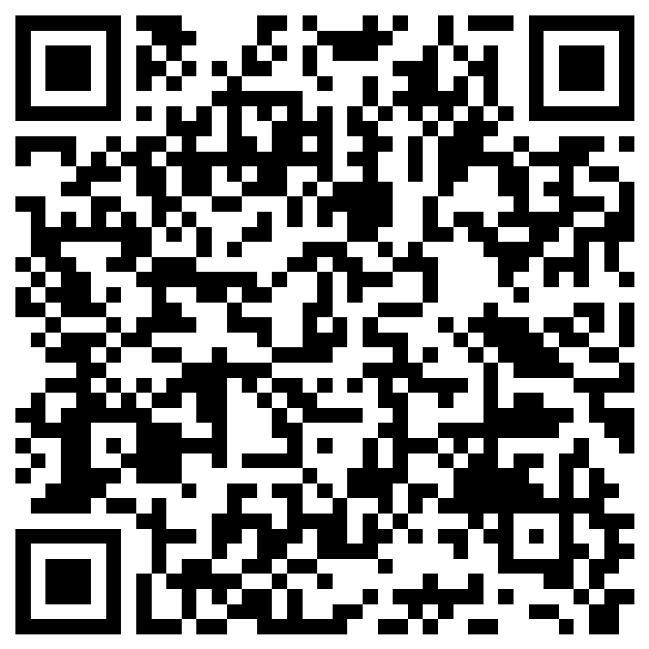
NAME THIS STORY
Table of Contents
Mommy lost the keys
First time in a shopping cart
I got a cookie!
The ice cream melted, dinner was still yummy
You could be a winner!
NAME THIS STORY HERE!

Slide 2

High perf developers
Skills intersection

Slide 3
Chris Berthold - Presenter
Over 20 years of experience in engineering scalable solutions and architecture
Currently a Lead Cloud Solutions Designer at Jackson National Life Insurance NYSE: JXN
Enjoys software architecture, simplifying software design and practical performance in cloud applications
Currently learning to play guitar
Private pilot
https://github.com/cberthold/presentations

Slide 4
AGENDA
Overview
Case study
5 Skills
Q & A

Slide 5

Overview
What you will learn about?
Topics or skills useful for everyday development
Introductions only
Tips, tricks and/or resources
Shown from easiest to hardest
Code demo included

Slide 6
Overview
High-Level Stories
SOLID Principles
Unit Testing
Design Patterns
Interfaces and Classes
Common Threads
Separating WHAT and HOW
Breaking up large functions
Maintainability and Organization
Requires Learning and Practice

Slide 7
Case STUDy
You are given a shopping cart that contains items, their prices and item totals
You’ve been asked to create an invoice and calculate invoice total
Product A Qty: 1 Unit Price: 4.99 Line: 4.99
Product B Qty: 4 Unit Price: 2.50 Line 10.00
Subtotal: 0.00
Tax: 0.00
Total: 0.00

Slide 8
SKILL – HIGH-LEVEL Story telling
“Unless you have definite, precise, clearly set goals, you are not going to realize the maximum potential that lies within you.” – Zig Ziglar
Who do you tell stories for?
Approach
Make your code tell a story
Expressed in sequences of steps or methods
Separate WHAT (abstract) from HOW (concrete)
Pass context and not complex transformations
Adjust the story to make sense – Refactor Early and Often
Focus on verbs and nouns that communicate intent and value
Tips
Write your steps down first (notebook, code) and then implement
Draw your steps and share with others
Benefits
Steps can be drawn and understood by others
Lots of simple methods are easier to refactor and re-use
Work can be broken down into smaller portions
Search For Keys
Search For Keys
Search The Couch
Search The Entry Way
Ride Shopping Cart
Pickup Groceries Around Store
Pay at the counter
Get A Cookie
Got a cookie in the bakery
Making Dinner
Mom made a delicious dinner
WHAT
The ice cream melted
HOW
Bring the groceries in
Enjoy cookie on the way home
Ride Shopping Cart
Get a Cookie
Making Dinner

Slide 9
Case STUDY – STORY TELLING – WHAT ARE THE STEPS?
Name this process
You are given a shopping cart that contains items, their prices and item totals
You’ve been asked to create an invoice and calculate invoice total
Name this step
Name this step
Product A Qty: 1 Unit Price: 4.99 Line: 4.99
Name this step
Product B Qty: 4 Unit Price: 2.50 Line 10.00
Subtotal: 0.00
Tax: 0.00
Total: 0.00
Name this step

Slide 10
Case STUDY – STORY TELLING – WHAT ARE THE STEPS?
InvoiceProcessor
You are given a shopping cart that contains items, their prices and item totals
You’ve been asked to create an invoice and calculate invoice total
Create Invoice
Calculate Invoice Subtotal
Product A Qty: 1 Unit Price: 4.99 Line: 4.99
Calculate Invoice Tax
Product B Qty: 4 Unit Price: 2.50 Line 10.00
Subtotal: 0.00
Tax: 0.00
Total: 0.00
Calculate Invoice Total

Slide 11
SKILL – INTERFACES AND CLASSES
“A picture is worth a thousand words. An interface is worth a thousand pictures.”
– Ben Shneiderman
Interfaces
Define contracts of what your class can do
They do not do anything
WHAT (abstract) it can do
Is-A – Composition over Inheritance
Allow swapping implementations at run-time
Classes
Implements interfaces and does the work
HOW (concrete) it does it
Tips
Avoid Abstract classes unless there is a clear pattern of re-use – temptation for virtual overrides
Interface per high-level step
When complexity rises – add an interface and move your code
Benefits
Interfaces and classes enable SOLID principles, Unit Testing, and Design Patterns
Interfaces allow swapping implementations
Basic -> Complex
Interfaces (WHAT)
Classes (HOW)
Person Run() Swim()
Talk()
interface ITalk
void Talk()
interface IRun
void Run()
Dog Run() Swim()
interface ISwim
void Swim()
Shark
Swim()

Slide 12
SKILL – SOLID PRINCIPLES
“You can't build a great building on a weak foundation. You must have a solid foundation if you're going to have a strong superstructure.”
– Gordon B. Hinckley
Approach
Focus on the S, I, and D in SOLID
Understand the O and L in SOLID
Set of guidelines and requires trade-offs at times
Favors interfaces to define functionality
Favors classes to group functionality
Tips
Combine SRP and ISP by approaching functionality from an interface perspective
CRUD = 4 interfaces
Make classes implement a single interface and refactor to more
Benefits
Allows simple re-use
Allows maintainable code
(S)RP – Single Responsibility Principle
One reason for change
(O)CP – Open/Closed Principle
Open for extension Closed for Change
(L)SP – Liskov Substitution Princple
Replacement of subclasses and superclasses shouldn’t break functionality
(I)SP – Interface Segregation Principle
Client shouldn’t be exposed to interfaces it doesn’t need
(D)IP – Dependency Inversion Principle
Depend on abstractions rather than concretions – Dependency Injection – don’t new a dependency in your code

Slide 13
SKILL – UNIT TESTING
“Testing leads to failure, and failure leads to understanding.– Burt Rutan
MethodBeingTested()
Approach
Focus on the happy path
Follow Arrange, Act, Assert
Focus on single assertions
Edge cases next
Tips
If it’s too hard to test, break out a class and method
Too many dependencies suggests class doing too much, break it up
Use mocks to simplify branching / Use stubs to understand them
Benefits
Allows code to be created and maintained with confidence
You’ll capture what should and shouldn’t work (negative tests)
Bugs are easier to diagnose by adding a new test
Can Force Branching
Method Input Parameters: param1 = 6
Can Be Asserted
var1 = param1 + 2
Mock/Spy of Interface1
Method Input Parameters: var1 = 8
Method Output outputVar = true
var2 = 5
if(outputVar) var2 = 7
Method Output: return var2

Slide 14
SKILL – DESIGN PATTERNS
“All fixed set patterns are incapable of adaptability or pliability. The truth is outside of all fixed patterns.”
– Bruce Lee
Approach
Don’t try to force use of patterns, see when they apply
Understand how the interface is being used, not the implementation
Tips
Look to Composite and Decorator for best code extension
Decorator can be thought of as Adapter with same interface
It adapts existing functionality with new functionality
Look to Builder for making fluent code
Look to Strategy for runtime swapping of algorithms or simplifying complex branching logic
Most examples are an expression of the pattern but they are only a guidance for structure
Benefits
Allows minimizing impact to working code
Look to patterns to help implement feature flags without touching existing code or swapping implementations at runtime
Composite Tax - Adds
CalculateTax
CalculateTax
CalculateTax
Basic Tax
Negative Tax Free Product A

Slide 15
SKILL – Final thoughts
Resources
Breaking It Down - https://blog.amazingmarvin.com/break-large-projects-tasks-bite-sized-tasks/
What are Interfaces? https://www.youtube.com/watch?v=MZOrGXk4XFI
SOLID Design Principles https://www.youtube.com/watch?v=9qvCeRt9_hM
Unit Testing - Mocks https://www.youtube.com/watch?v=DwbYxP-etMY
Design Patterns in C# https://www.youtube.com/playlist?list=PLOeFnOV9YBa4ary9fvCULLn7ohNKR6Ees
Don’t be discouraged
It takes time and practice to learn
Tips
Read/research (30 mins or less) on a topic each day

Slide 16

Thank You
Twitter: @cberthold

